Slide 1
Measure Carbon Emission of the Application and Optimization
Team
Arka Chakraborty , 202000084
Aayush Sharma , 202000164
Gangotri Bhattarcharjee , 202000007
Prandeep Chiring Phukan , 202000173
Shirsh Khandelia , 202000366
Contribution of Team 4 under the mentorship of Dhilip Kumar Sir

Slide 2
Agenda items
Delegation of work and timeline
Analysis and Optimization
Parameters
Formula
Layout of Website
Documentation
References
Prototype

Slide 3
Delegation of work and timeline
Analysis and Approach 1
(Datasets and Code Carbon)
Approach 2
(Websites and Formula)
Mentoring Session 1
(Approach confirmed)
Formula Developed
+
Working on Optimisation
Mentoring Session 2
(Working on prototype)

Slide 4
2. Analysis and Optimization
Analysis:
No existing formula (hardware independent)
Possibilities (Website, Extension)
Approach:
Develop formula and algorithm based on datasets, parameters
Create a website (input: code) and (output: carbon emission and optimisation recommendation)
Recommend optimization by scanning uploaded code

Slide 5
2. Analysis and Optimization
Optimization Approach :
Convert submitted code to assembly language
Extract assembly language code and scan it
Algorithm :
Scan for : load , store , goto , if , invokevirtual , mul , div
Recommend solution based on scanned assembly language
Further implementation:
Implement unrolling loop, function length, data type conversion for all languages.

Slide 6
3. Parameters
Carbon proxies :
Frontend – energy required to render the webpage
Networking – data size , page weight is a carbon proxy.
Backend - Servers are hardware and have embodied carbon as they released carbon in their creation. Therefore, servers are carbon proxies.
Parameters discarded ! WHY ?
The parameters were not hardware independent .

Slide 7
3. Parameters
New parameters :
Running time
Allocated memory
Other parameters ( configured as per local system and country)
Parameters approved ! WHY ?
The parameters were focusing on the software side.

Slide 8
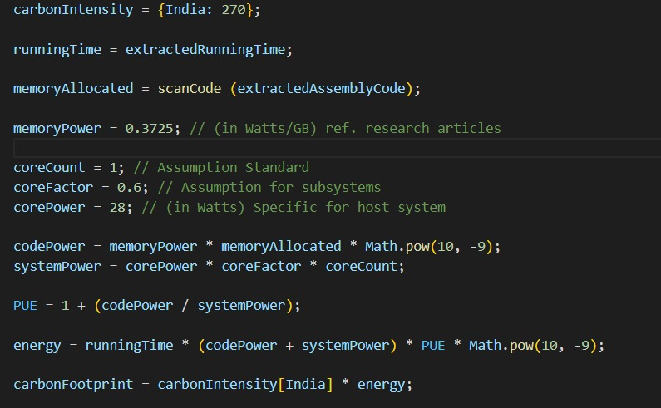
4. Formula
Derived formula :

Slide 9
4. Formula
Derivation :
E = t*[(Pm * Nm * 10^-9)+(Pc * Uc * Nc)]*PUE*10^-9
Where t is the running time
Pm is the power drawn from memory i.e. experimentally estimated as 0.3725 W/GB
Nm is the total memory allocation which will be analyzed from the code
Pc is the power drawn of computing core ie a pre calculated configuration of 28w acc to the host computer.
Uc is the core usage factor which is 0.6 which is the standard benchmark of host computer according to our ref.
PUE = 1 + (Code Power / System Power)
Carbon Footprint = Carbon Intensity (CI) * E
Code Power = Pm * Nm
System power = Pc * Uc * Nc

Slide 10
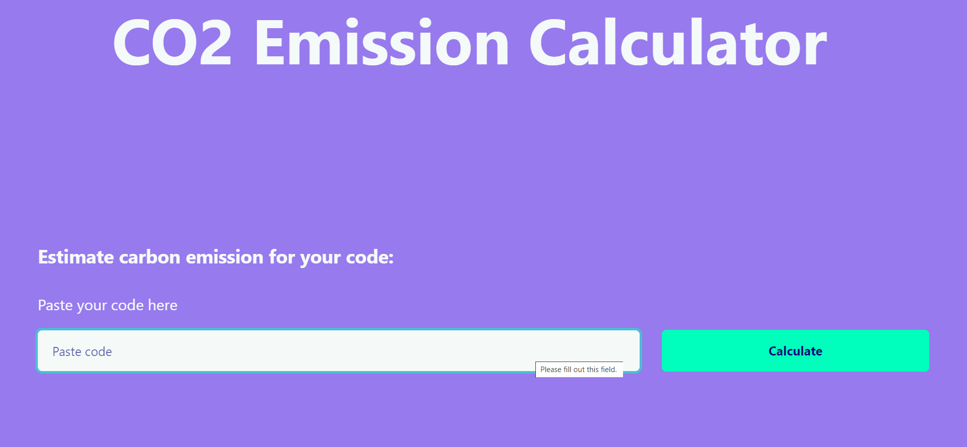
5. Layout of Website

Slide 11
5. Layout of Website
Components :
Header
Text field
Submit button
Future scope :
Implement a feature to upload url’s and paste files
Users can directly paste files from Github repository

Slide 12
6. Documentation
Functional Requirements:
scanCode(string) – To read the extracted assembly code, suggest optimizations and return the time and memory formula parameters.
userAction – Compiler API implementation, takes code (say, Java) as input and provides JSON with assembly implementation as output.
Formula code
Non-Functional Requirements:
Processor: 11th Gen Intel(R) Core(TM) i5-1135G7 Installed RAM: 8 GB System type: 64-bit operating system, x64-based processor
Browser: Any modern browser (Chrome, Firefox, Edge)

Slide 13
6. Documentation
Error Log:
CORS error – Connection issue while fetching from API. This in-turn results in failed API calls.
File, JSON, String conversions
Parameter fetching from API

Slide 14
7. References
green-algorithms.org
ourworldindata.org/co2/country/india
godbolt.org
ark.intel.com/content/www/us/en/ark/products/208658/intel-core-i51135g7-processor-8m-cache-up-to-4-20-ghz.html
cpubenchmark.net/cpu.php?cpu=Intel+Core+i5-1135G7+%40+2.40GHz&id=3830
Google Scholar research articles on Carbon Emission of Data Centres

Slide 15
8. Prototype
Let’s take a look at our live implementation.

Slide 16
Thank You

